Slide 1
World’s First Intelligent 3D Design Platform 全球首家智能3D设计平台
2017. 08

Slide 2
Product & Use Cases
产品概况
Development Roadmap
产品方案
Competitor Analysis
竞争对手及风险分析
Market Analysis
市场分析
Go To Market Strategies
商业模式
Funding Request
资金需求
Team Intro
团队介绍

Slide 3
Use Cases
产品使用环境

Slide 4


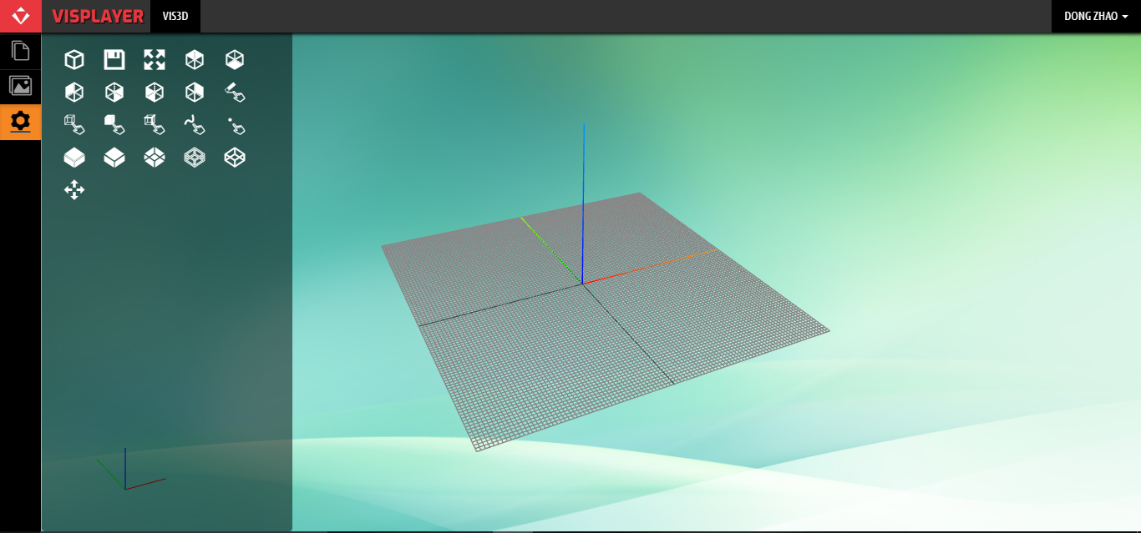

Login via web

Slide 5
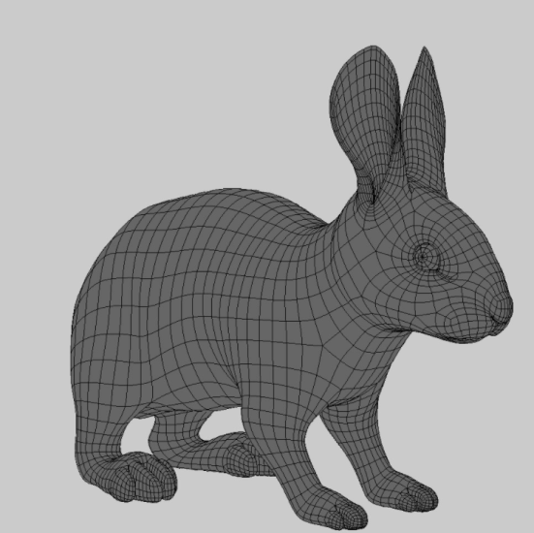
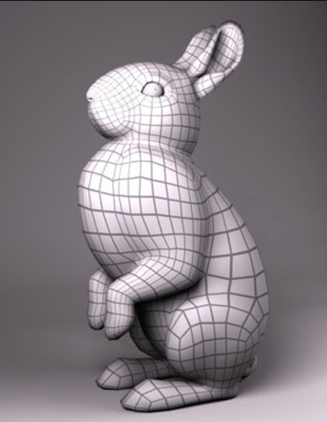
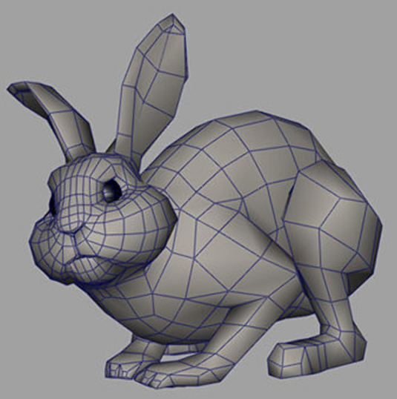
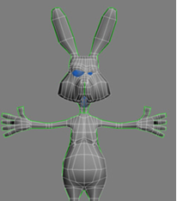
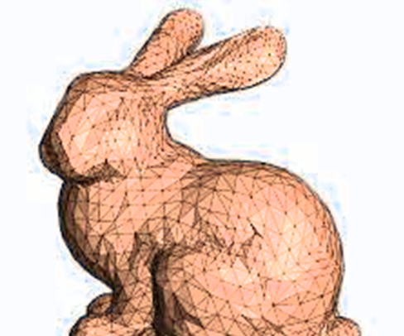
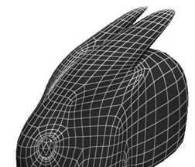
Searching for 3D Models

Slide 6
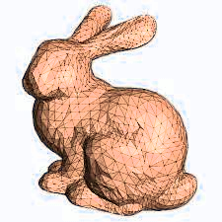
Choose 3D model

Slide 7
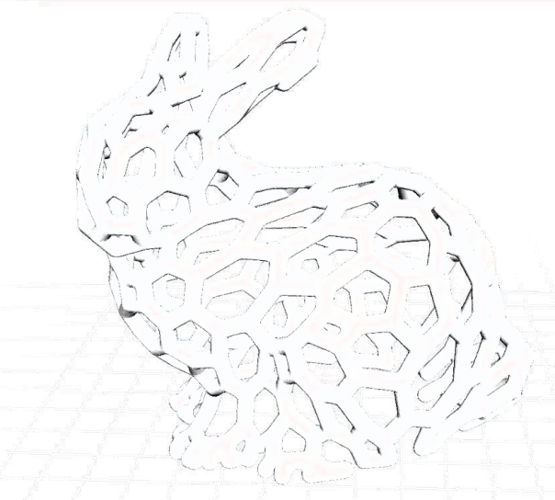
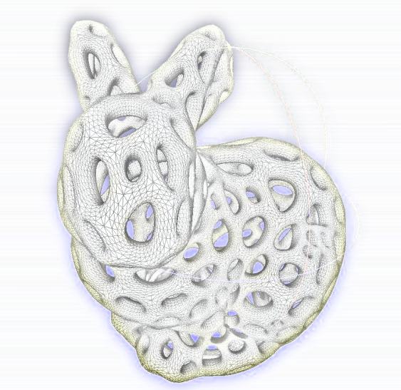
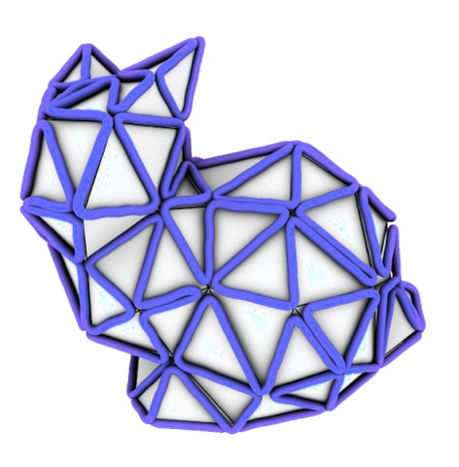

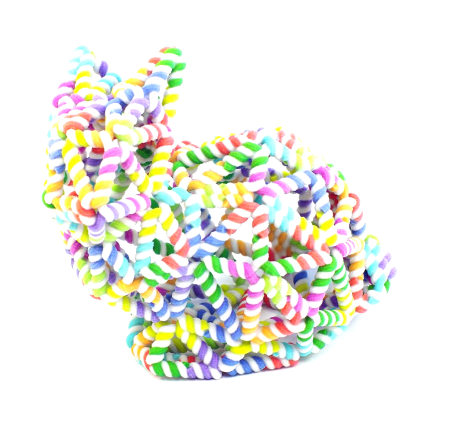
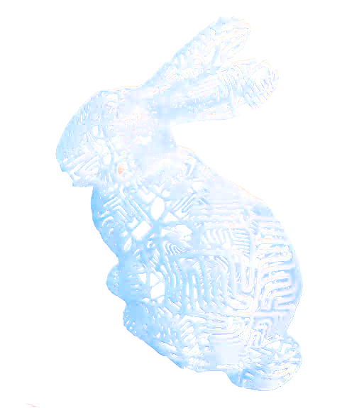
Apply filters
...
...

Slide 8
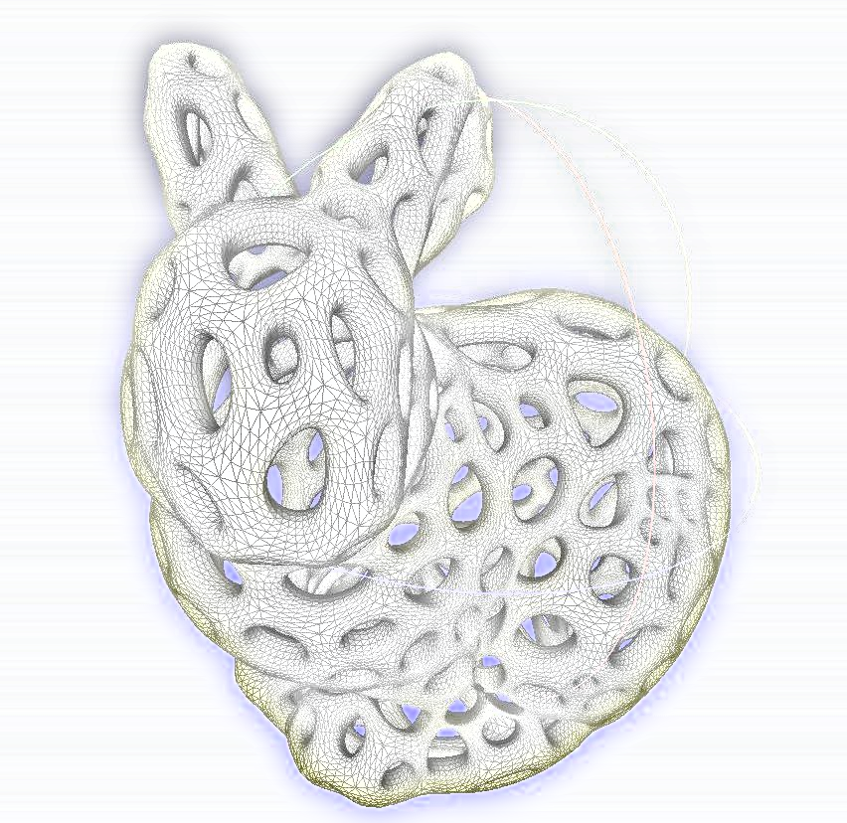
Editing and printing 3D Model

Slide 9
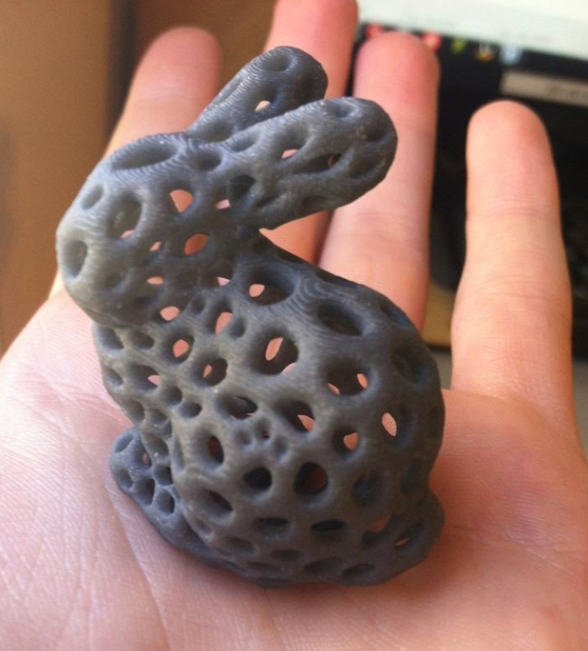

Slide 10
Product Introduction
产品概况

Slide 11

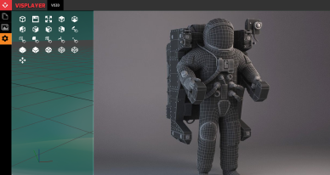
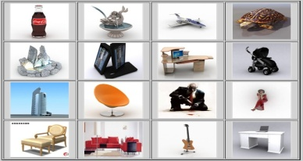
Product Differentiation 产品特征
Global Platform 全球访问
Easy to Use 简单易用
Improved Modeling Method
领先建模方法
Make Modeling Fun
建模更有趣
3D Intelligent Design Platform
3D 人工智能化设计平台
3D Design Eco System
3D 设计生态圈

Slide 12
Targeted Industry 产品应用行业
Personalized Items
个性化物品
Education
教育
Toys
玩具
Tools
工具
Gaming
游戏
Furniture
家具
Automotive
汽车
Aerospace
航天航空
Medical
医疗
Office
企业办公
Manufacturing
制造业
Others
其它

Slide 13

Company Structure 公司区域架构
Toronto CA
加拿大多伦多
Beijing CN
中国北京
Detroit MI
美国底特律
Shenzhen CN
中国深圳

Slide 14
Competitive Advantage 核心技术
First in the world
3D filter
全球首家
3D 滤镜
First in the world
3D design AI Engine
全球首家
3D设计人工智能学习引擎
Inte. 3D Model Repository
智能3D模型数据库
3D Intelligent Design Platform
3D 人工智能设计平台
First in the world
Mesh 3D Design
全球首家
Mesh 3D设计
3D API
3D打印功能及接口

Slide 15
Platform Advantage 平台水平
World’s First Intelligent 3D Design Platform
世界首家智能3D设计平台
Global Access from Cloud
云端全球访问
Intelligent Modeling
智能化建模
Make 3D Modeling Easy and Fun
更简单和好玩的3D建模
3D Model Eco System
3D模型生态圈

Slide 16
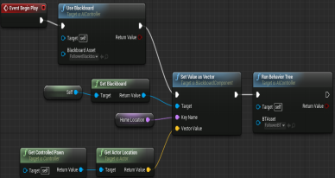
World easiest and most fun 3D design platform
全球最简单有趣的3D设计平台
Cloud Based云基础
Easy to Use简单易用
Mesh Modeling网格模型
3D Model Repository
3D模型数据库
Subscription认购
3D filter 滤波器
3D Design & Printing
3D设计&打印
3D model database
3D模型数据库
3D Data AI Engine
3D数据人工智能引擎
Furniture家具
Personalized Items个性化物品
Education教育
Automotive汽车
Targeted Industry
目标行业:
Tools工具
Toys玩具

Slide 17
Product Advantage
产品方案

Slide 18
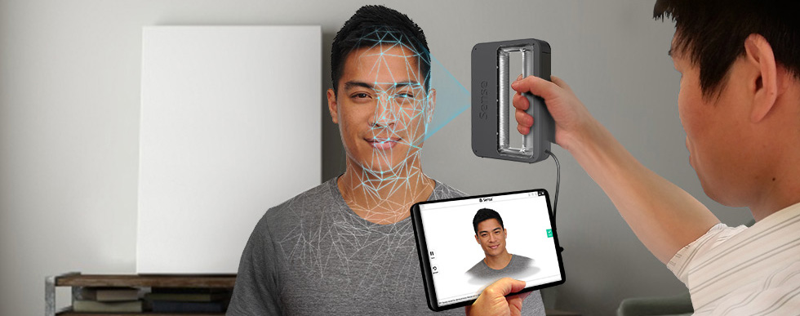
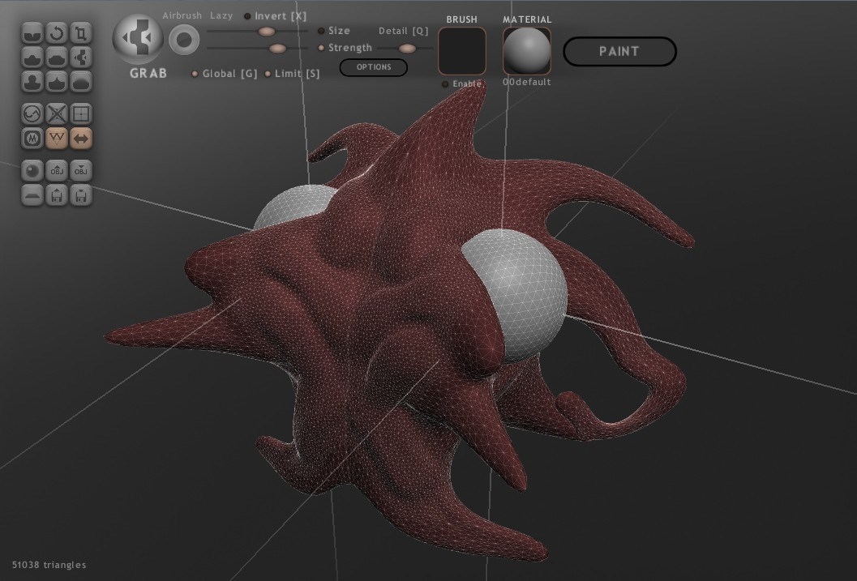

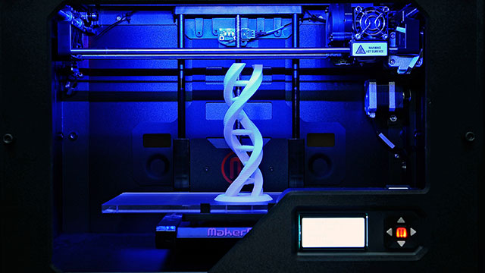
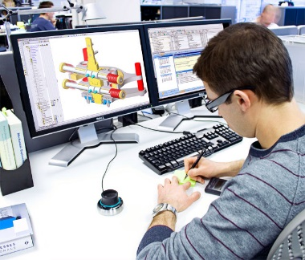
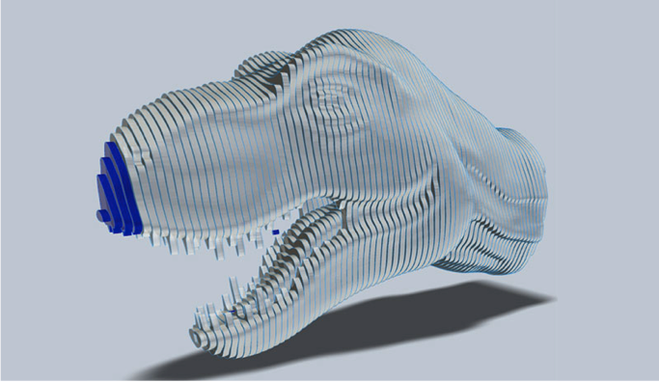

Simplify 3D Design Process 简易 3D 设计流程
3D Scanning / Modeling
3D扫描/建模型
3D Model Editing 模型编辑
Mesh Repair
网格修补
Mesh Editing
网格编辑
Mesh Validation
网格校验
Modeling
建模
Sculpturing
塑刻
3D Printing/Make
3D打印或制造
3D Preprocessing
预处理
Design for Manufacturing
制造设计
G-Code Generation
易录代码生成
Mesh Slicing
网格刨切

Slide 19
Simplify 3D Design Process 简易 3D 设计流程
3D Intelligent Modeling
3D 智能化设计
3D Scanning / Modeling
3D扫描/建模型
3D Model Editing 模型编辑
Mesh Repair
网格修补
Mesh Editing
网格编辑
Mesh Validation
网格校验
Modeling
建模
Sculpturing
塑刻
3D Printing/Make
3D打印或制造
3D Preprocessing
预处理
Design for Manufacturing
制造设计
G-Code Generation
易录代码生成
Mesh Slicing
网格刨切

Slide 20
3D Design System - Traditional 3D设计链 – 传统
3D Model Capture/Ini
3D 模型捕捉/生成
3D Model Editing
3D 模型编辑
3D Model Slicing
3D 模型处理
3D Model Making
3D 模型建造

Slide 21
3D Design Eco System 3D设计生态链
3D Design Eco System
Build and edit models with AI design engine
More Efficient
More Effective
Easy to learn
3D 设计生态圈
人工智能引擎设计并编辑模型
更有效
便捷
简单易学
3D Model Capture
3D 模型捕捉
3D Model Editing
3D 模型编辑
3D Model Slicing
3D 模型处理
3D Model Making
3D 模型建造

Slide 22
3D Design Eco System 3D设计生态链
3D Design Eco System
Market place for Designers
Designers build models and filters
Designers sell models and filters
3D 设计生态圈
设计师的市场
设计师建模并建滤镜
设计师销售模型和滤镜
3D Model Capture
3D 模型捕捉
3D Model Editing
3D 模型编辑
3D Model Slicing
3D 模型处理
3D Model Making
3D 模型建造

Slide 23
3D Design Eco System 3D设计生态链
3D Design Eco System
Vertical Integration
Integration with 3D printers
Integration with 3D scanners
3D 设计生态圈
纵向一体化
与 3D 打印集成
与 3D 扫描集成
3D Model Capture
3D 模型捕捉
3D Model Editing
3D 模型编辑
3D Model Slicing
3D 模型处理
3D Model Making
3D 模型建造

Slide 24
Technical Advantage 关键技术
3D Model AI Repository
3D模型智能数据库
3D Mesh Design & Editing
Mesh 3D设计&处理
3D Design AI Engine
3D设计人工智能引擎

Slide 25
Development Roadmap
开发计划

Slide 26
Roadmap and Timeline 产品路线图和时间表
70 | 95 | 25
115 | 135 | 50
2017 & 2018 Phase 1
First Go-Live
2019 Phase 2
Future
150 | 165 | 30
XXX
Product development
产品开发
Continue product version 2.0 development
开发2.0版
Continue PD
持续开发
Alpha release
Beta release
XXX
Design team expansion 扩大设计团队
Language and region expansion 扩大地区和语言范围
XXX
XXX
Marketing for Go-Live
为系统上线营销
Corporate with educational institutions 和教育机构合作
Other Industries
进入其他行业
XXX
XXX
Corporate with 3D printer manufacturers
和3D打印厂商合作
XXX
XXX
3D model database 3D模型数据库
XXX
3D model AI Engine
3D模型人工智能引擎
XXX
XXX
XXX

Slide 27
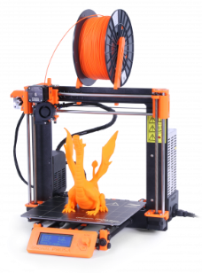
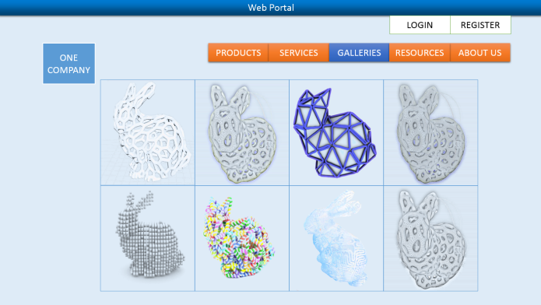
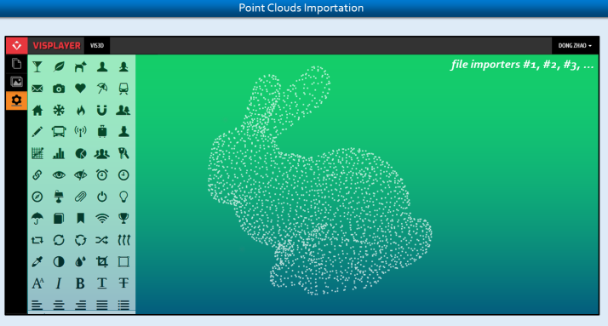
Functionalities in each phase 各阶段的功能
Version 1.0 (end of 2018)
1.0版 （2018年底）
3D Framework框架
3D Model Repository模型库
3D Reconstruction重建
3D Modifiers编辑
Version 2.0 (end of 2019)
2.0版（2019年底）
Visual Computing (3D processing template)
视觉计算（3D工艺模板）
AI Engine人工智能引擎
Mobile version (APP)手机版
Search
Edit
Print

Slide 28
Competitor Analysis
竞争对手分析

Slide 29
Competitive Analysis 竞争对手分析
Software | Function | Geometry |  |  |  |  | Modeling |  |  |  | Manufacturing |  |  |  |  |  | Level | Price | System
 |  | Voxel | Mesh | Polygon | Subdivision | NURBS | Block | Laminate | Clay | Parametric | STL Viwer | STL Checker | STL Repair | STL Eidtor | Slicer | Hosting
123D Catch | Design |  | √ |  |  |  |  |  | √ |  |  |  |  |  |  |  | Beginner | Free | PC, Web, Mobile
123D Design | Design |  |  |  |  | √ |  |  |  | √ |  |  |  |  |  |  | Beginner | Free | PC, Web, Mobile
123D Make | Design |  | √ |  |  |  |  | √ |  |  |  |  |  |  |  |  | Beginner | Free | PC, Web, Mobile
123D Sculpt+ | Design |  | √ |  |  |  |  |  | √ |  |  |  |  |  |  |  | Beginner | Free | PC, Web, Mobile
3D View / Build | Design |  | √ |  |  |  |  |  | √ |  | √ |  |  |  |  |  | Beginner | Free | PC
3D-matic | Editinig |  | √ |  |  |  |  |  | √ |  | √ | √ | √ | √ | √ |  | Professional | Proprietary | PC
3DReshaper | Editinig |  | √ |  |  |  |  |  | √ |  | √ | √ | √ | √ |  |  | Professional | Proprietary | PC
3DTin | Design |  |  |  |  | √ |  |  |  | √ |  |  |  |  |  |  | Beginner | Free | Web
3D-Tool Free Viewer | Viewer |  | √ |  |  |  |  |  |  |  |  |  |  |  |  |  | Intermediate | € 60,000 | PC
Blender | Design |  |  |  | √ |  |  |  | √ | √ |  |  |  |  |  |  | Professional | Free | PC
ChronoSculpt | Design |  | √ |  |  |  |  |  | √ |  |  |  |  |  |  |  | Professional | $399 | PC
ClayTools | Design |  | √ |  |  |  |  |  | √ |  |  |  |  |  |  |  | Professional | Proprietary | PC
CraftWare | Printing |  |  |  |  |  |  |  |  |  | √ |  |  |  | √ | √ | Beginner | Free | PC
Cura | Printing |  |  |  |  |  |  |  |  |  | √ |  |  |  | √ | √ | Beginner | Free | PC
DesignX | Design |  | √ |  |  |  |  |  | √ |  |  |  |  |  |  |  | Professional | Proprietary | PC
Dreamcatcher | Design |  | √ |  |  |  |  |  |  |  |  |  |  |  |  |  | Beginner | Free | Web
Dynamo | Design |  |  |  |  | √ |  |  |  | √ |  |  |  |  |  |  | Professional | $300/y | PC
Form-Z Pro | Design |  | √ |  |  |  |  |  | √ |  |  |  |  |  |  |  | Professional | Proprietary | PC
FreeCAD | Design |  |  |  |  | √ |  |  |  | √ |  |  |  |  |  |  | Intermediate | Free | PC
Freeform Plus | Design |  | √ |  |  |  |  |  | √ |  |  |  |  |  |  |  | Professional | Proprietary | PC
Fusion 360 | Design |  | √ |  | √ | √ |  |  | √ | √ |  |  |  |  |  |  | Professional | Free, $300/y | PC
GrabCAD | Viewer |  | √ |  |  | √ |  |  |  |  |  |  |  |  |  |  | Beginner | Free | Web
Grasshopper | Design |  |  |  |  | √ |  |  |  | √ |  |  |  |  |  |  | Beginner | Free | PC
Inspire | Optimization |  | √ |  |  |  |  |  |  | √ |  |  |  |  |  |  | Professional | Proprietary | PC
Meshfix | Editinig |  | √ |  |  |  |  |  | √ |  |  |  | √ |  |  |  | Intermediate | Free | DOS
MeshLab | Editinig |  | √ |  |  |  |  |  | √ |  | √ | √ | √ | √ |  |  | Professional | Free | PC
Meshmixer | Editinig |  | √ |  |  |  |  |  | √ |  | √ | √ | √ | √ |  |  | Professional | Free | PC

Slide 30
Competitive Analysis 竞争对手分析
Highlights of industry movement:
行业活动亮点
Autodesk acquired 26
CAD design companies in the last 6 years
过去6年Autodesk（美国3D软件巨头）收购了26家CAD设计公司
Lagoa raised 3 rounds in total of $8.4 M, was acquired by Autodesk on Nov 20, 2014 for $60M (Apr 2013 $1.6 M, Dec 2013 $5.3M, Feb 2014 $1.6M)
Lagoa（3D设计公司）3轮融资840万美金（2013年4月160万，2013年12月530万，2014年2月160万），2014年11月被Autodesk以6000万美金价格收购。
TinkerCAD raised $1 M in round 1 in Nov 2011, was acquired by Autodesk on May 5, 2013 for unknown amount
TinkerCAD（在线3D建模平台）2011年11月第一轮融资100万美金，2013年5月被Autodesk收购
Software | Function | Geometry |  |  |  |  | Modeling |  |  |  | Manufacturing |  |  |  |  |  | Level | Price | System
 |  | Voxel | Mesh | Polygon | Subdivision | NURBS | Block | Laminate | Clay | Parametric | STL Viwer | STL Checker | STL Repair | STL Eidtor | Slicer | Hosting
Netfabb | Editinig |  | √ |  |  |  |  |  | √ |  | √ | √ | √ | √ | √ |  | Intermediate | € 1,500 | PC
OctoPrint | Printing |  |  |  |  |  |  |  |  |  |  |  |  |  |  | √ | Professional | Free | Web
OnShape |  |  |  |  |  | √ |  |  |  | √ |  |  |  |  |  |  | Professional | Free | Web
P3D.in | Viewer |  | √ |  |  |  |  |  |  |  |  |  |  |  |  |  | Beginner | Free | Web
ParaView | Viewer |  | √ |  |  |  |  |  |  |  |  |  |  |  |  |  | Professional | Free | PC, Web
PCL | Library |  | √ |  |  |  |  |  |  |  |  |  |  |  |  |  | Professional | Free, $300/y | PC
Recap |  |  | √ |  |  |  |  |  |  |  |  |  |  |  |  |  | Beginner | Free | Web
Remake | Editinig |  | √ |  |  |  |  |  | √ |  | √ | √ | √ | √ |  |  | Professional | Free, $300/y | PC
Repetier | Printing |  |  |  |  |  |  |  |  |  | √ |  |  |  | √ | √ | Intermediate | Free | PC, Web
Sculptris | Design |  |  |  | √ |  |  |  | √ |  |  |  |  |  |  |  | Beginner | Free | PC
Shapeshifter | Design |  | √ |  |  |  |  |  |  | √ |  |  |  |  |  |  | Beginner | Free | Web
Simplify3D | Printing |  |  |  |  |  |  |  |  |  | √ | √ | √ |  | √ | √ | Professional | $149 | PC
SketchFab | Viewer |  | √ |  |  |  |  |  |  |  |  |  |  |  |  |  | Beginner | Free | Web
SketchUp | Design |  |  | √ |  |  |  |  |  | √ |  |  |  |  |  |  | Intermediate | Free | PC
Slic3r | Printing |  |  |  |  |  |  |  |  |  | √ | √ | √ |  | √ |  | Professional | Free | PC
TinkerCAD | Design |  |  |  |  | √ |  |  |  | √ |  |  |  |  |  |  | Beginner | Free | Web
Vectary | Design |  |  |  | √ |  |  |  |  | √ |  |  |  |  |  |  | Intermediate | Free | Web
Visit | Viewer |  | √ |  |  |  |  |  |  |  |  |  |  |  |  |  | Professional | Free | PC
VTK | Library |  | √ |  |  |  |  |  |  |  |  |  |  |  |  |  | Professional | Free, $300/y | PC
VXmodel | Editinig |  | √ |  |  |  |  |  | √ |  | √ | √ | √ | √ |  |  | Professional | Proprietary | PC
Within | Optimization |  | √ |  |  |  |  |  |  | √ |  |  |  |  |  |  | Professional | Proprietary | PC

Slide 31
Market Analysis
市场分析

Slide 32
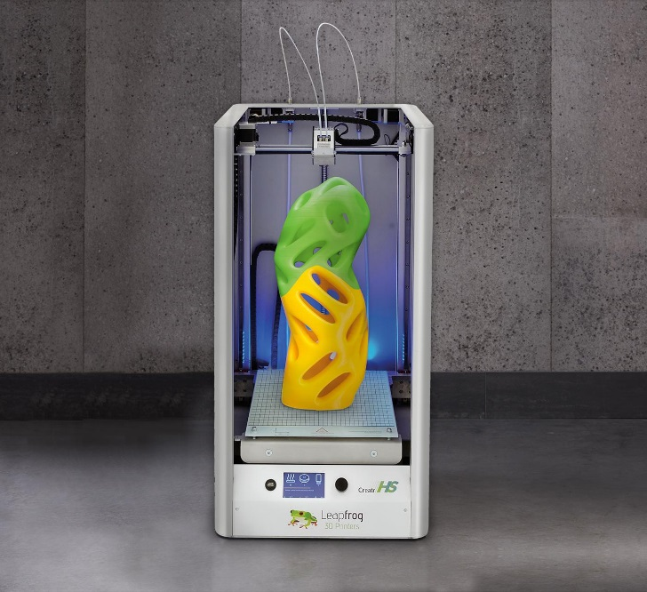
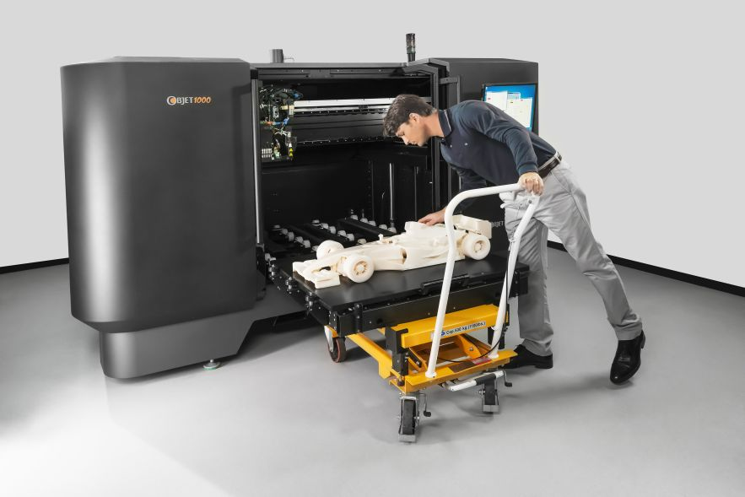
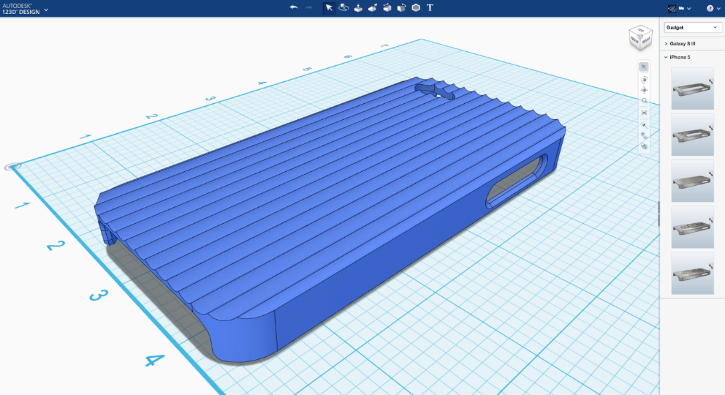
3D Printing Design Market 3D打印设计市场
3D printer is becoming a commodity 3D打印机已成为日用品
300,000 3D printer sold in 2016 在2016年，3D打印机售出30万台
3D printers to grow triple digit percentage in next 5 - 10 years
未来5-10年，3D打印机数量会成倍增长
Challenge: Easy-to-use 3D design tool is much needed 简单易用的3D设计工具是必要的需求
Other 3D image capture devices

Slide 33
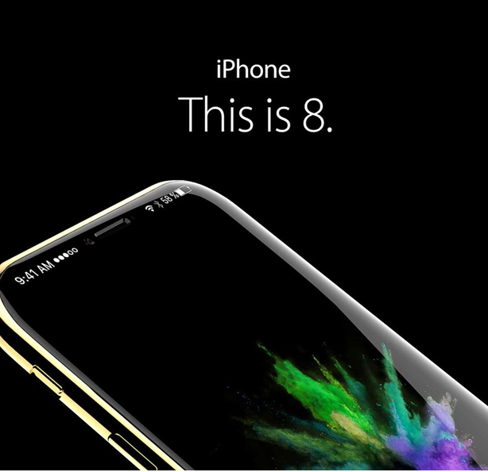
3D Image Capture Devices 3D图像捕捉设备
Largan Precision, one of the current suppliers for the iPhone's camera lens component, confirmed that it will ship lenses for 3D sensing modules in the second half of 2017, suggesting inclusion in the next-generation "iPhone 8." The confirmation comes from Largan CEO Adam Lin
Largan Precision（大力光电），是苹果手机摄像头部件供应商，预示下一代苹果手机摄像头将加入3D传感模块

Slide 34
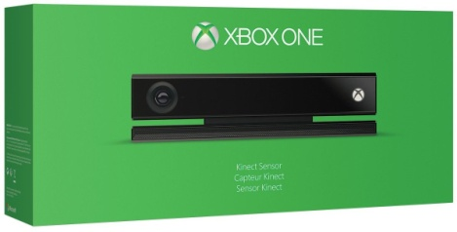
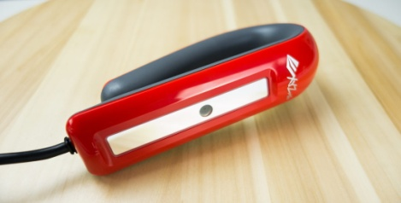
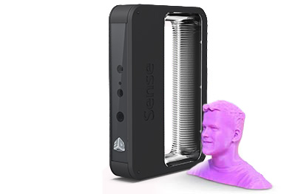
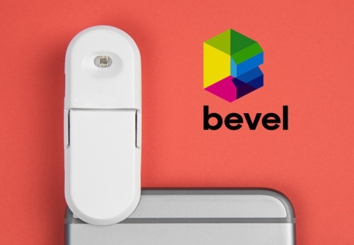
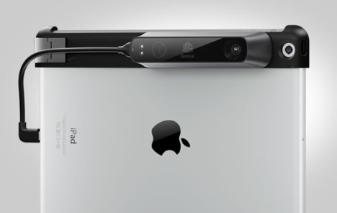
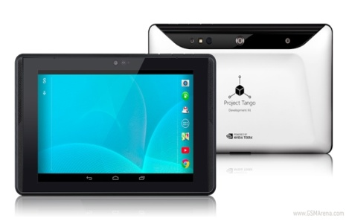
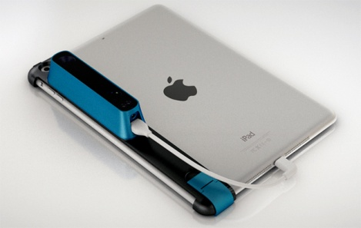
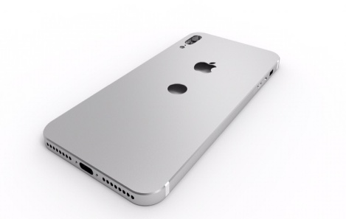
3D SCANNING Devices 扫描设备
XBOX ONE
XYZ 3D Scanner
XYZ 3D Scanner
Sense
Bevel Scanner
Bevel Scanner
iSense
Project Tango
Project Tango
Structure Sensor
iPhone
iPhone

Slide 35
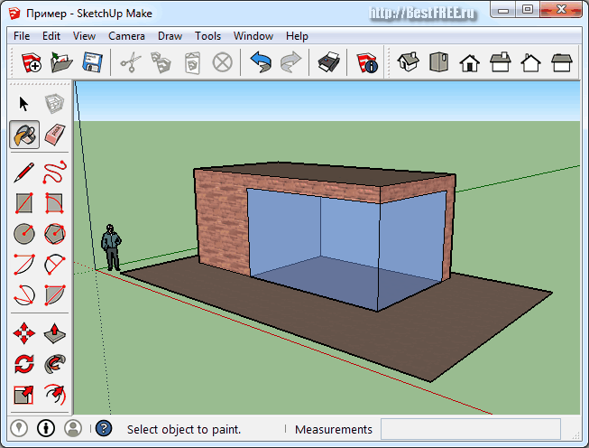
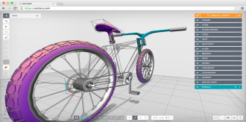
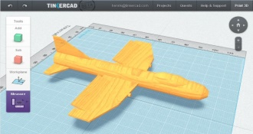
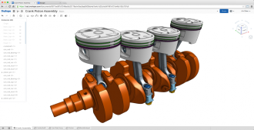
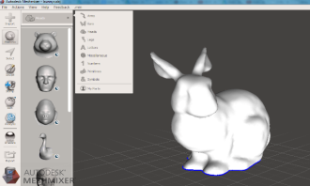
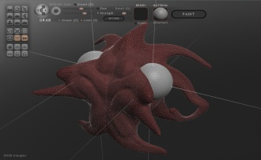
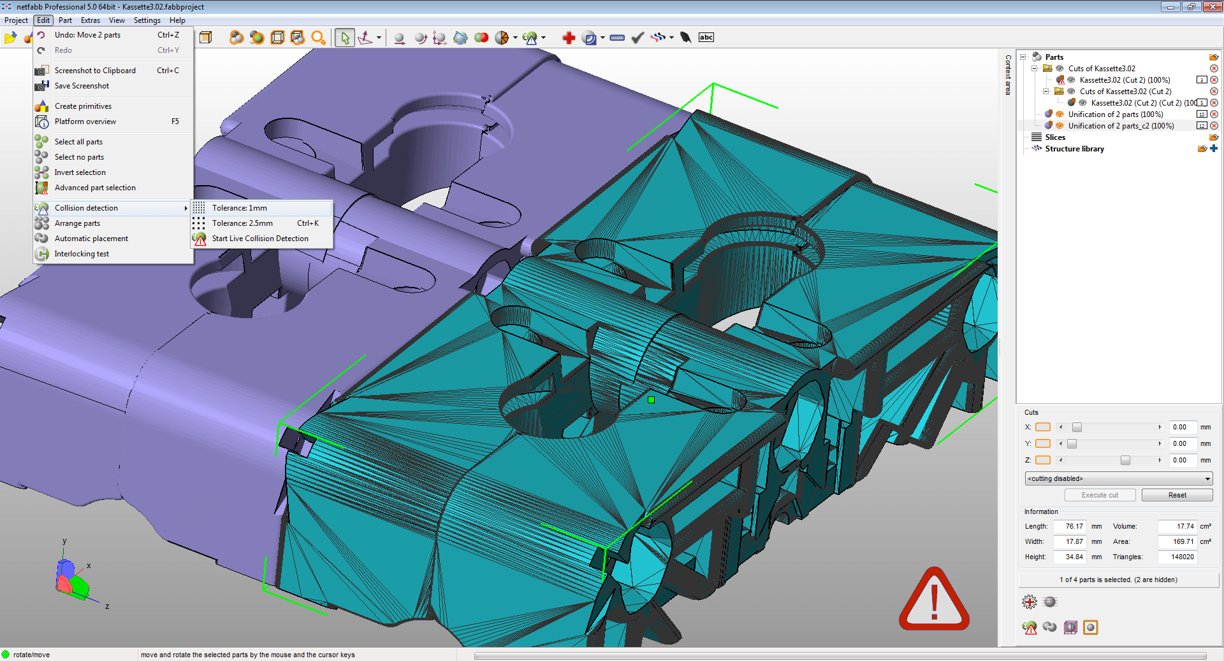
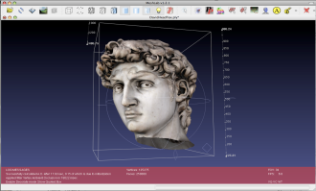
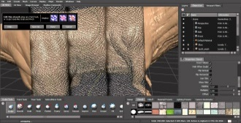
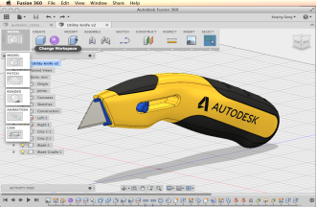
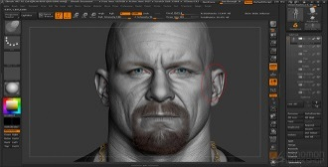
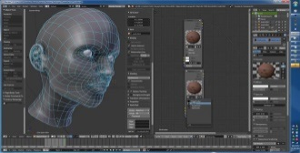
3D MODELING 3D建模
Technology
MESH
SUBDIVISION
NURBS
BLANK
Usability

Slide 36
3D MODELING 3D建模
Technology
MESH
SUBDIVISION
NURBS
Difficult to model
建模困难
No industry standard editor
没有行业标准
Hard to learn to model
很难学习
Very expensive to buy
购买昂贵
No model base to search/re-design
没有模型库可供搜索/再设计
BLANK
Usability

Slide 37

















3D PREPROCESSING 3D预处理
...
...
...

Slide 38
3D PREPROCESSING 3D预处理
...
Very Chaotic
非常杂乱
3D printer manufacturing develops editing tool
3D打印厂商开发编辑工具
No industry standard format
没有行业标准格式
No knowledge base / lesson learned
没有知识基础/经验总结
...
...

Slide 39

3D PRINTING 3D打印
Ultimaker Ultimaker 2+
CEL Robox
Original Prusa i3 MK2
Zortrax M200
CraftBot PLUS
Printrbot Simple Metal
LulzBot TAZ 6
Replicator 5th Gen

Slide 40
3D PRINTING 3D打印
There are over 500 3D printer manufacturers in the world
全球有超过500家3D打印厂商
Scattered software design tool
软件设计工具散乱
High costs for 3D printer manufactures to develop and support their own design tool
3D打印厂商自己开发设计工具成本高
Small 3D printer manufactures pay for manual 3D model editing
小型3D打印制造商需付人工费编辑建模
Ultimaker Ultimaker 2+
CEL Robox
Original Prusa i3 MK2
Zortrax M200
CraftBot PLUS
Printrbot Simple Metal
LulzBot TAZ 6
Replicator 5th Gen

Slide 41

Current Challenges目前的挑战
Design tools设计工具
Deep learning curve深度学习曲线
Transition training from one CAD system to another takes 4-8 weeks, costs $20,000 - $500,000 based on number of users
CAD系统的培训需要4-8周，成本$20,000 - $500,000（根据使用者数量）
eLearning online account costs ~$10,000 annually
在线学习成本$10,000 /年
Accessibility 可及性
Based on 20 yrs + technology 基于20年以上的技术
Pricing model 定价模式
Cost成本
Traditional CAD system costs $10,000 - $30,000 per user + 20% - 30% annual maintenance fee
传统CAD系统成本$10,000 - $30,000/用户 + 20% - 30% 维护费/年
3D Printing 打印
Standard tools and processes 标准化工具和制程
3D model search ability 3D模型搜索能力
3D Data Intelligence (Data AI)人工智能数据
3D model recognition模型识别 – model searching模型搜索
3D processing template/module工艺模板 – knowledge reuse

Slide 42
Go To Market Strategy
商业模式

Slide 43
Go To Market Strategy
商业模式
3D Intelligent Design Platform
3D 人工智能化设计平台
Data
数据
Services
服务
Functionalities
功能
Hardware
硬件

Slide 44
Go To Market Strategy - Data
商业模式 - 数据
How to Sell
销售模式
Designer sells on platform
个人在平台销售
Companies from different industries sells on platform
行业设计公司在平台销售
Who to Buy
目标客户
Customers
个人用户
Businesses
行业公司
Advantage
销售优势
Biggest database
最大模型数据库
Lower cost
降低成本

Slide 45
Go To Market Strategy - Functionalities
商业模式 - 功能
How to Sell
销售模式
Subscription
订购
Business Partner Program
公司合作伙伴模式
Who to Buy
目标客户
Customers
个人用户
Businesses
行业公司
Advantage
销售优势
Easiest modeling method
最简易建模方法
Lower cost of development
降低开发成本

Slide 46
Go To Market Strategy - Services
商业模式 - 服务
How to Sell
销售模式
Training
培训
Outsourcing Services
服务外包
Who to Buy
目标客户
Customers
个人用户
Businesses
行业公司
Advantage
销售优势
User Base
用户基础
Technology know-how
专业技术知识
3D modeling and slicing
3D 建模处理

Slide 47
Go To Market Strategy - Hardware
商业模式 - 硬件
How to Sell
销售模式
3D scanner
3D 扫描设备
Who to Buy
目标客户
Customers
个人用户
Businesses
行业公司
Advantage
销售优势
User Base
用户基础
Up Stream Design foundation
掌握上游设计
3D printer & materials
3D 打印机和材料

Slide 48
Go To Market Strategy 销售模式
End User Subscription Pricing Model
用户认购
Basic software is free to use基础软件免费使用
Partner Program
(3D printer manufacturers / resellers)
伙伴计划（3D打印厂商/代理）
Silver: $200 per user for 12 months < 500 users annually
Pro version $19.99 / month (limited to print 10 models)专业版19.99美金每月，限制打印10个模型
Pro Plus version $49.99 / month (unlimited)专业加强版49.99美金每月，无限次使用
Gold: $180 per user for 12 months between 500 and 1000 users annually
Platinum: $150 per user for 12 months > 1000 users annually
银级：每年200美金每个用户（小于500个用户）
金级：每年180美金每个用户（500-1000个用户）
白金级：每年150美金每个用户（大于1000个用户）
Market Place for designers
(models and filters)设计师
10% of sale price售价的10%
3D Filters 3D滤镜
Price varies: $1.99~ $9999.99 depends on complexity
3D Models模型
Price varies: $0.99 ~ $9999.99 depends on model
价格区间： 基于模型种类
价格区间：基于复杂程度
Functionalities in version 1.0 Functionalities in version 2.0

Slide 49

Global CAD Market (Professional) 全球专业CAD设计市场
Source：2017 Cadalyst

Slide 50
Short Term Sales Projection 三年销售预期
(In millions USD 单位：百万美金）

Slide 51
Long Term Sales Projection 后期销售预期
(In millions USD 单位：百万美金）

Slide 52

Financial Projections 财务预测
User projection 用户规划
Goal is to have 20,000 user by end of 2019 在2019年底达到2万用户
E.g. $19.99 / month X 2,000 users (10% of all users) = $40,000 / month
举例$19.99 月X 2,000 用户(10%的付费比例) = $40,000 / 月
Annual user target:用户目标
2020: 50,000 users (5,000 paid user) 2020年达到5万用户（其中5千为付费用户）. $100,000/month
2021: 100,000 users (10,000 paid user) ) 2021年达到10万用户（其中1万为付费用户）. $200,000/month
Partner program with 3D printer manufacturers / contractors
伙伴计划（3D打印厂商/承包商）
E.g. biggest 3D printer manufacturer sells 80,000 3D printers in 2016
Target 3 printer manufactures/contractors for 10,000 users in 2019
目标： 2019年3D打印厂商/承包商带来10,000用户
Estimate预计: $150 X 10,000 = $1,500,000 每年
Annual user target:用户目标
2020: $ 3 Mil
2021: $ 6 Mil
Total: 合计
First Year第一年 (2019): $40,000 X 12 + $1,500,000 = $1,540,000
Second Year 第二年(2020): $100,000 X 12 + $3,000,000 + others = $5,000,000
Third Year第三年 (2021): $200,000 x 12 + $6,000,000 + others = $13,000,000

Slide 53
Funding Request
资金需求

Slide 54
2018 Financial Plan for Release 1.0 2018费用
Items | Sub-Items |  | Units | Unit Price | Expenses
Rental租金 | Office办公室 |  | 12 | $5,000 | $60,000
Assets资产 | Workstation 工作站 |  | 6 | $5,000 | $30,000
Salaries工资 | Development 开发人员 | Full Stack Developer | 1 | $90,000 | $90,000
 |  | Geometry Algorithm Developer | 1 | $100,000 | $100,000
 |  | Product Developer | 1 | $80,000 | $80,000
 |  | Document Writer (second half of the year) | 1 | $50,000 | $50,000
 | Marketing营销 | Marketing material | 1 | $60,000 | $60,000
Other expense 其它开销 | Cloud Rental 租借云服务器 | 9 month after Alfa release | 9 | $1000 | $9,000
 | Domain rental 域名 | 12 month | 12 | $50 | $600
 | Travel 差旅 | every month for marketing/meeting travel | 12 | $1000 | $12,000
 | Backoffice 后台支持 | payroll | 12 | $1000 | $12,000
 | Administration运营 |  | 12 | $ 5000 | $60,000
Release 1 Financial Needs 资金需求 |  |  |  |  | ~$540,000

Slide 55
Organization Plan 核心团队

Slide 56
Charles Wang – CEO
Dong Zhao – CTO
Maureen Huber – CFO
Geometry Algorithm Developer
几何算法开发员
Product Developer
产品开发员

Slide 57

CHARLES WANG - CEO
Over 12 years in CAD PLM Industry as Sales and Business Development
Understanding of industry trends and customer needs
Energetic, passionate and spread-headed to revolutionize CAD PLM industry
WORK EXPERIENCE
Technical Account Manager (Siemens PLM)
Project/Program Manager (Siemens PLM)
Business Development Director (Rocket Software)
EDUCATION
MBA, Eli Board Business School (Michigan State University)
B.Sc, Computer Science (Wayne State University)

Slide 58

DONG ZHAO - CTO
3D design programmer for over 20 years
Development Team lead and CAD design expert
Very Passionate in 3D design and development
WORK EXPERIENCE
Research Lead / Senior Software Developer
3D Industry Verterian (10+ Years)
CAD (Siemens PLM NX, SolidWorks, CATIA,...)
CAE (Fluent, Comsol, Forming Suite,...)
Skills in Geometry, Graphics and Computing
Geometry Processing
Computational Geometry
Computer Graphics
Computer Vision
Artificial Intelligence
EDUCATION
Ph.D. , Mechanical Engineering, University of Calgary
M.Sc, Automotive Engineering, Tongji University
B.Sc, Automotive Engineering, Tongji University

Slide 59

MAUREEN HUBER - CFO
Over 20 years as CFO in Software Industry
Held varies high level position in Software Companies including CFO, CEO, Board of directors, etc.
Entrepreneur mentality and very knowledgeable regarding industry M&A market
WORK EXPERIENCE
CFO/ COO (Stratus Video)
Board of Directors (Vista Maria)
Vice President (Rocket Software)
President & Chief Executive Office (Trubiquity)
EDUCATION
MBA, Eli Board Business School (Michigan State University)
Finance (Michigan Stage University)

Slide 60
Thank You

